Slide 1
WannaCry Ransomware
Ted Gould
@tedjgould
Allen Rotary
May 17, 2017

Slide 2
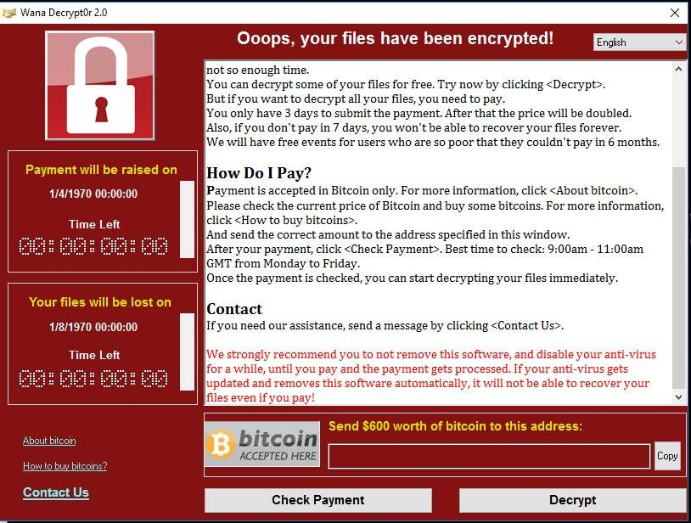
What happened?

Slide 3
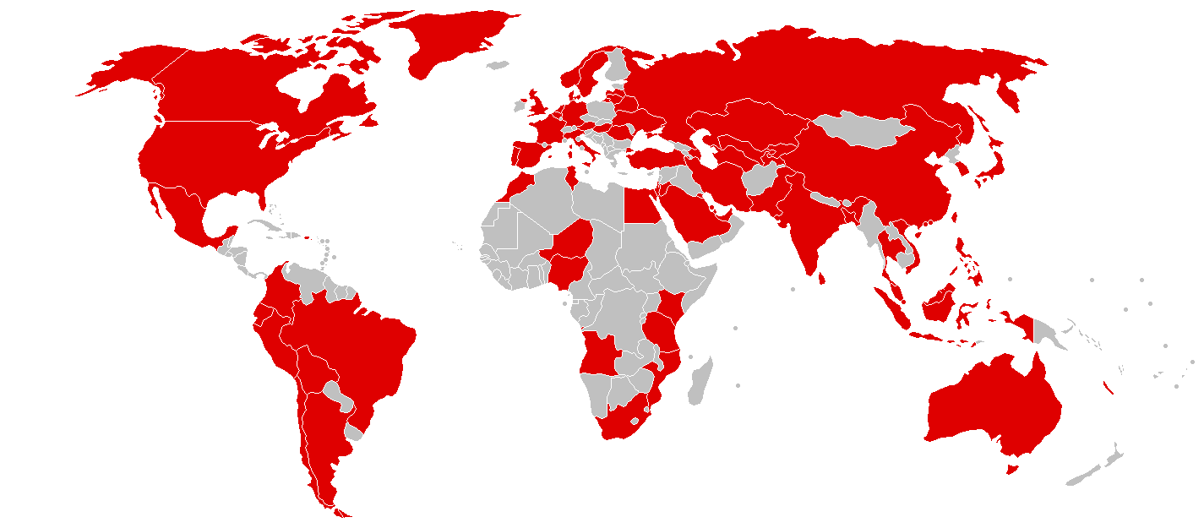
Where?
Europol estimates ~200K computers in 150 countries
Map By User:Roke - File:BlankMap-World-v2.png, CC BY-SA 3.0, https://commons.wikimedia.org/w/index.php?curid=58863465

Slide 4
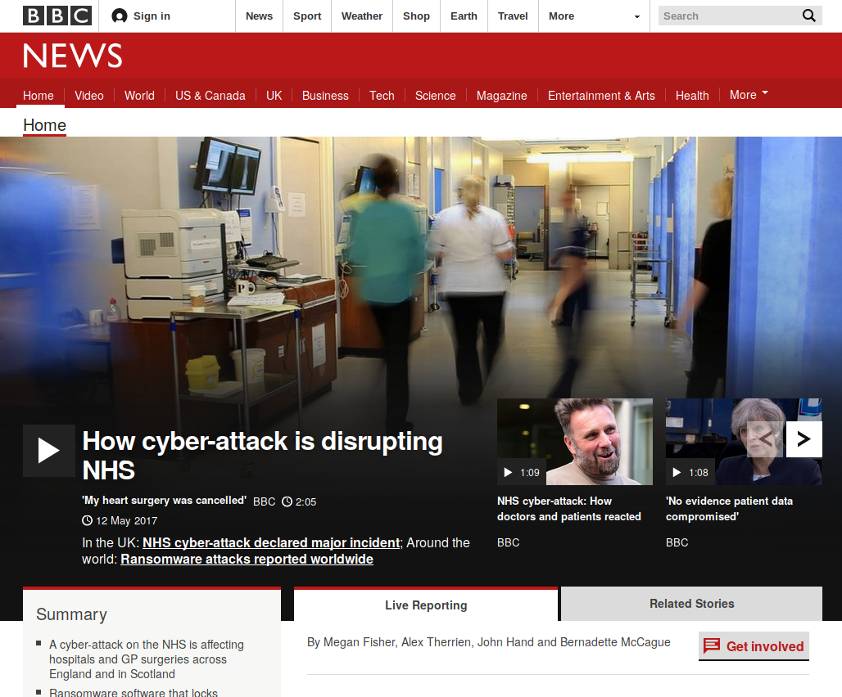
NHS Deminished Service

Slide 5
What should you do right now?
Mac OS, Ubuntu, Chrome OS: Keep up-to-date
Windows
  Apply all security updates (XP especially vulnerable)
  Disable SMB1 if possible (Windows network sharing)
  Update to supported versions of Windows (and other OSes) as soon as possible

Slide 6
How does it work?
Encrypts documents on the computer
Looks on the network for other computers to infect using the EternalBlue SMB exploit
Requests Payment to a Bitcoin Wallet ($300 to $1000)
Installs a backdoor in the machine

Slide 7
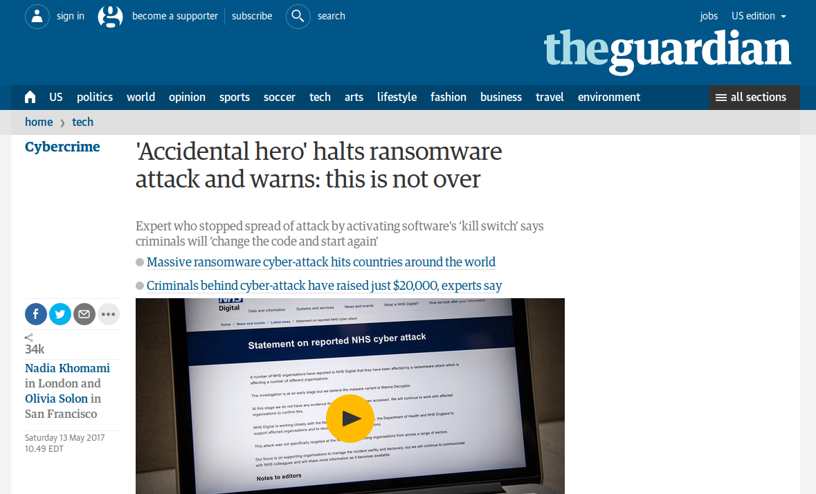
Encryption Stopped
https://www.theguardian.com/technology/2017/may/13/accidental-hero-finds-kill-switch-to-stop-spread-of-ransomware-cyber-attack

Slide 8
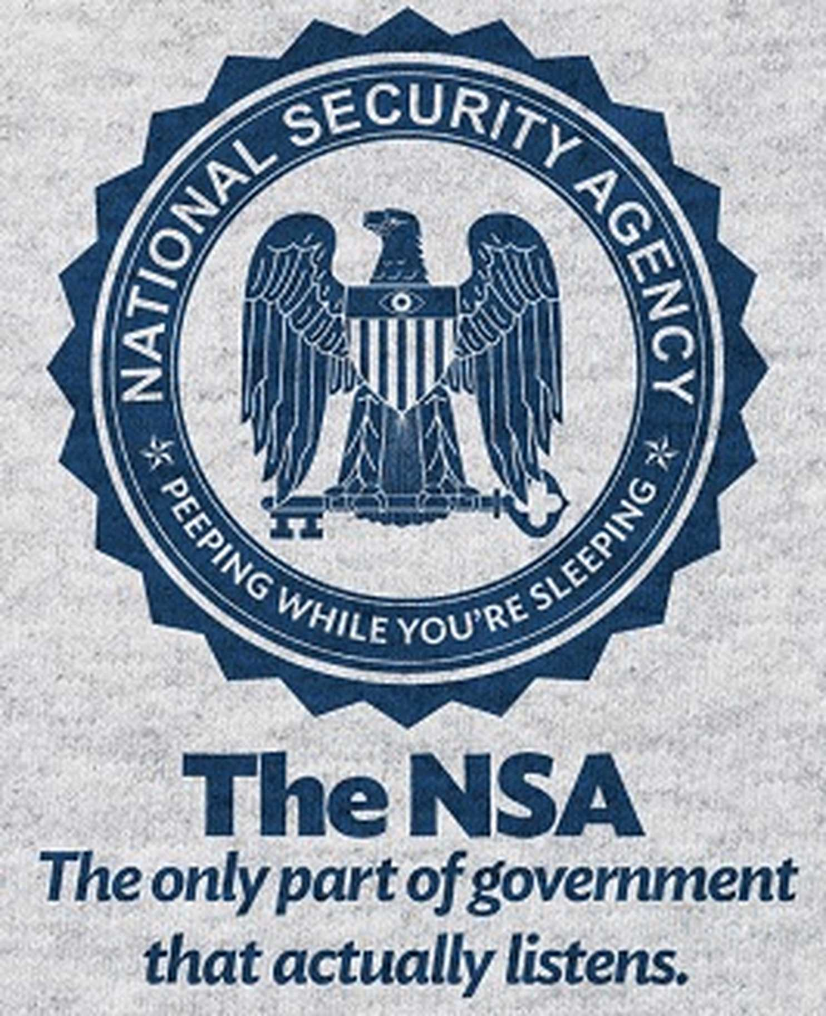
Who made EternalBlue?
Believed to be the NSA
Leaked publicly (along with many other tools) on April 14th, 2017 (some believe by a foreign adversary)
NSA is believed to have other zero-day (unpatched) vulnerabilities

Slide 9

Should the US gov’t have zero days?
“Finally, this attack provides yet another example of why the stockpiling of vulnerabilities by governments is such a problem. This is an emerging pattern in 2017. We have seen vulnerabilities stored by the CIA show up on WikiLeaks, and now this vulnerability stolen from the NSA has affected customers around the world. Repeatedly, exploits in the hands of governments have leaked into the public domain and caused widespread damage. An equivalent scenario with conventional weapons would be the U.S. military having some of its Tomahawk missiles stolen. And this most recent attack represents a completely unintended but disconcerting link between the two most serious forms of cybersecurity threats in the world today – nation-state action and organized criminal action.”
https://blogs.microsoft.com/on-the-issues/2017/05/14/need-urgent-collective-action-keep-people-safe-online-lessons-last-weeks-cyberattack/

Slide 10
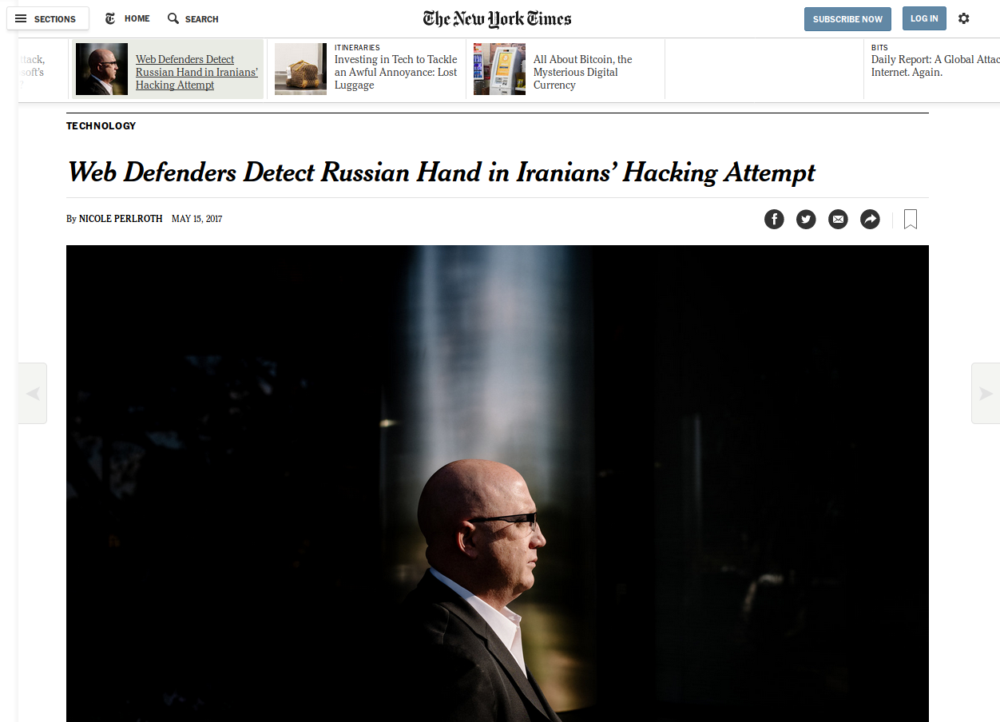
Should the US gov’t pay for zero days?
https://www.nytimes.com/2017/05/15/technology/web-defenders-detect-russian-hand-in-iranians-hacking-attempt.html

Slide 11
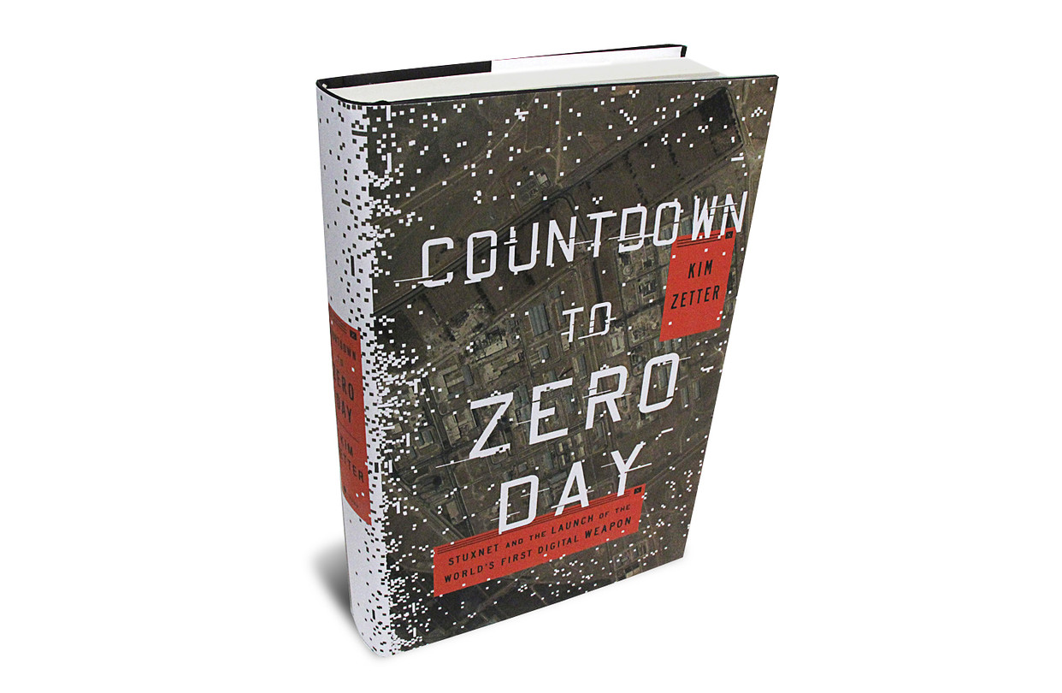
Book on Stuxnet (gov’t viruses)

Slide 12
Why?
Money?
  Ransomware requires a fee to decrypt, sometimes paying that fee results in getting the decryption keys
  It appears people trying to pay overwhelmed the attackers (which would imply they weren’t ready for the response)
Politics?
  Since it was an NSA exploit someone may have been trying to embarrass the NSA or USA
Joy riders?
  Information was publicly available, so literally anyone could have done it

Slide 13
What to do about Ransomware?
BACKUPS!!!
(air gapped or offline if possible)

Slide 14
What if I get Ransomware?
Shutdown computer
  Some ransomware may not have encrypted all files
  Worms may be continuing to look for additional targets on your network
Get help
  Talk to a computer professional about how to fix the machine. This will likely including formatting (deleting all the data) the machine and returning it to a safe state
Notify customers via disclosure policy
  You have a disclosure policy, right? Right? Important to let customers know similar to a physical break in.

Slide 15
Questions?
Slides: http://gould.cx/ted/presentations/

